Slide 1
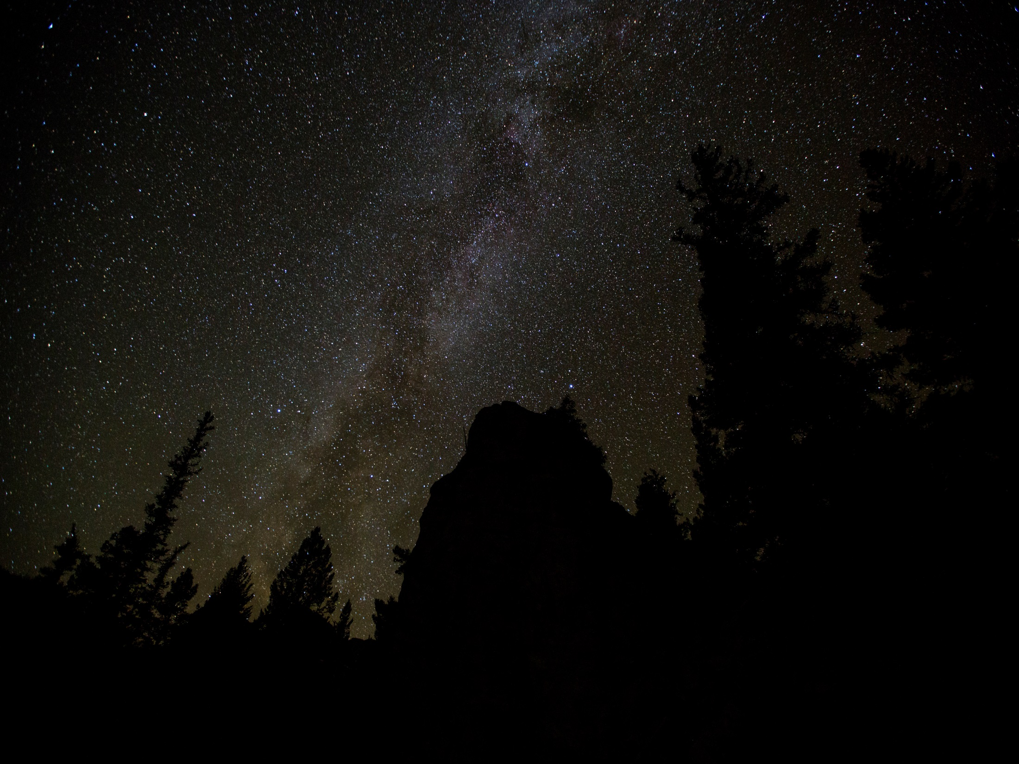
Workout Summary
Time
1:21:30
Distance
5.0
Calories
216
Save

